Slide 1

Note: The data and information in this document is reflective of a hypothetical situation and client. This document is to be used for KPMG Virtual Internship purposes only.
Sprocket Central Pty Ltd
Data analytics approach
[Division Name] - [Engagement Manager], [Senior Consultant], [Junior Consultant]

Slide 2
Note: The data and information in this document is reflective of a hypothetical situation and client. This document is to be used for KPMG Virtual Internship purposes only.
Agenda
Introduction
Data Exploration
Model Development
Interpretation

Slide 3
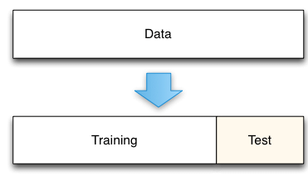
Note: The data and information in this document is reflective of a hypothetical situation and client. This document is to be used for KPMG Virtual Internship purposes only.
Introduction
The data and analysis is to reveal useful customer insights which could be help optimise resource allocation for targeted marketing, therefore to improve performance by focusing on high value customer.
Examining ways to boost business by analyzing their customer dataset to determine customer trends and behavior.
Using the existing 3 datasets (customer demographic, customer address and transactions as labelled dataset), and the new customer as target to drive the most value for the generation.
Phases for a detailed approach in completing the analysis include Data Exploration, Model Development and Interpretation.
Place any supporting images, graphs, data or extra text here.

Slide 4
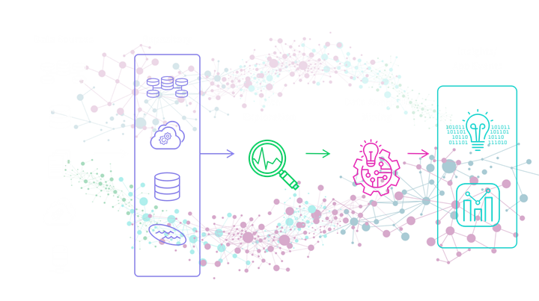
Note: The data and information in this document is reflective of a hypothetical situation and client. This document is to be used for KPMG Virtual Internship purposes only.
Data Exploration
This is to visualize and statistically summarize and analyze a dataset to gain a better understanding of its key characteristics, uncover patterns, identify anomalies, and generate insights.
It's an essential part of data analysis to make informed decisions about how to proceed with their analysis, what methods to use, and what insights to prioritize.
key activities in the phase includes.
Data Cleaning and Preprocessing
data quality.
Descriptive Statistics
Data Visualization

Slide 5
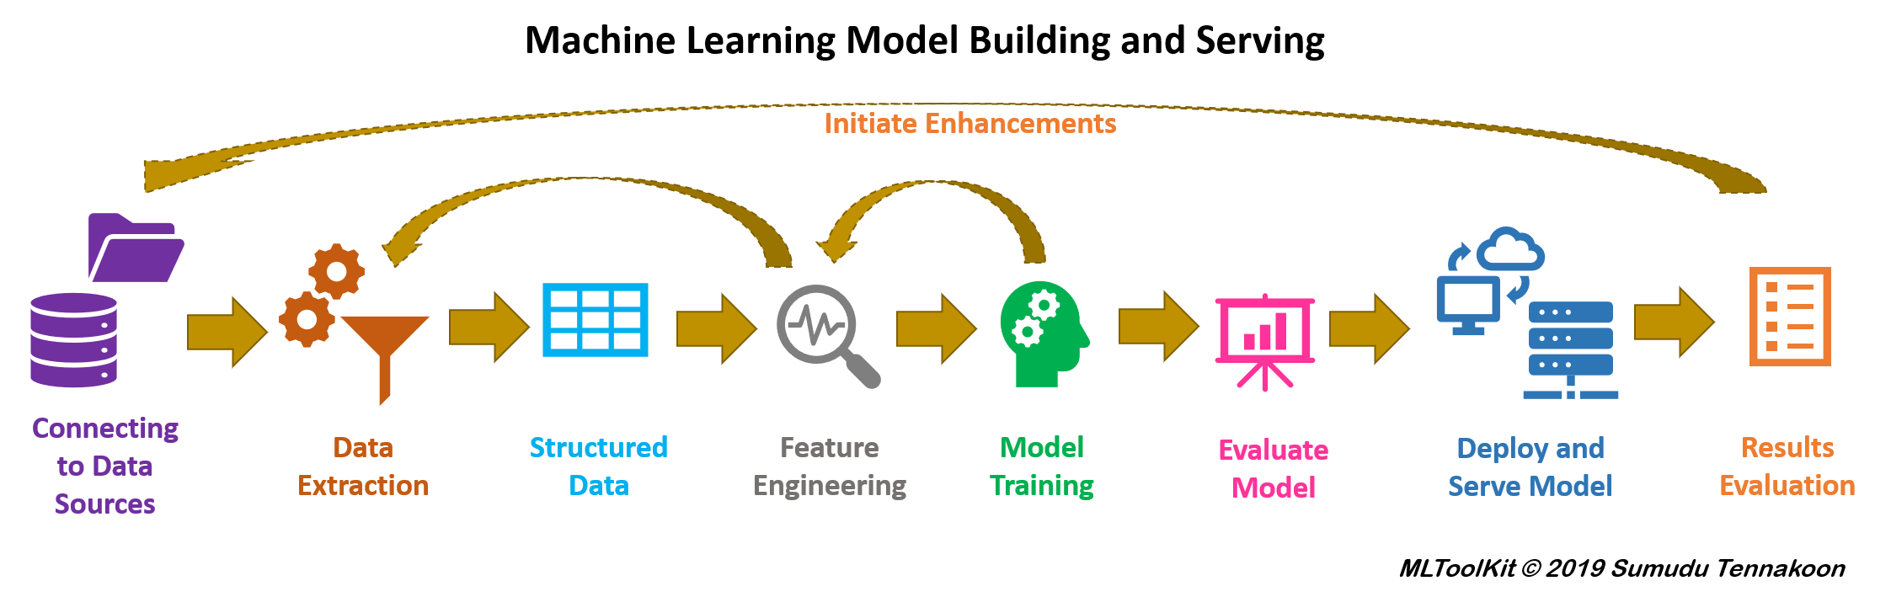
Note: The data and information in this document is reflective of a hypothetical situation and client. This document is to be used for KPMG Virtual Internship purposes only.
Model Development
This is essential phase in analysis to build and train predictive models using the cleaned and preprocessed data. and it requires careful planning, experimentation, and validation to ensure that the chosen model meets the objectives and performs well on new data.
key activities in this phase, includes
model selection,
feature engineering, and
model training/validation.

Slide 6
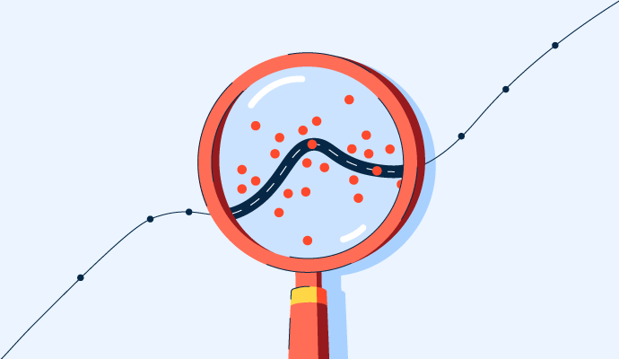
Note: The data and information in this document is reflective of a hypothetical situation and client. This document is to be used for KPMG Virtual Internship purposes only.
Interpretation
This is a crucial aspect of the analysis process that involves understanding and explaining the results and predictions generated by a trained model. And provides insights on how and why the model makes specific decisions or predictions.
key activities in this phase includes
Feature Importance Analysis
Model Insights
Business Recommendations

Slide 7
Note: The data and information in this document is reflective of a hypothetical situation and client. This document is to be used for KPMG Virtual Internship purposes only.
Appendix

Slide 8
Note: The data and information in this document is reflective of a hypothetical situation and client. This document is to be used for KPMG Virtual Internship purposes only.
Appendix
This is an optional slide where you may place any supporting items.

